Slide 1
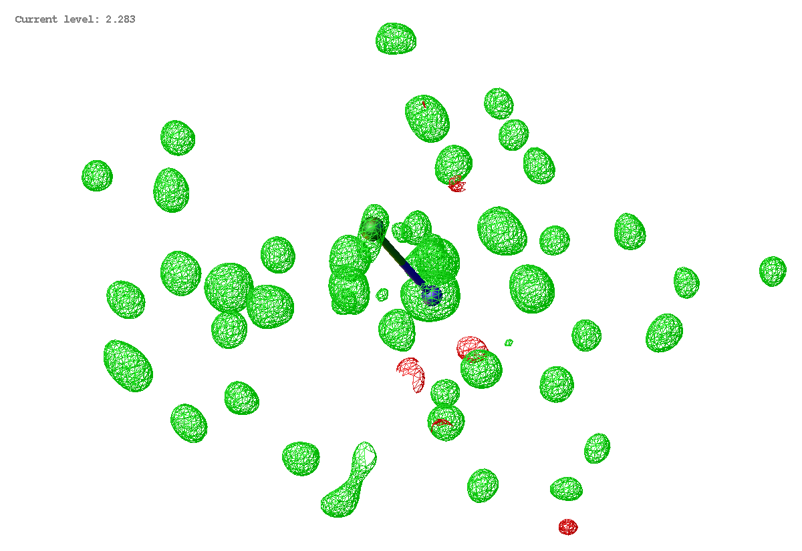
Integrate reflections

Slide 2
Integrate reflections

Slide 3
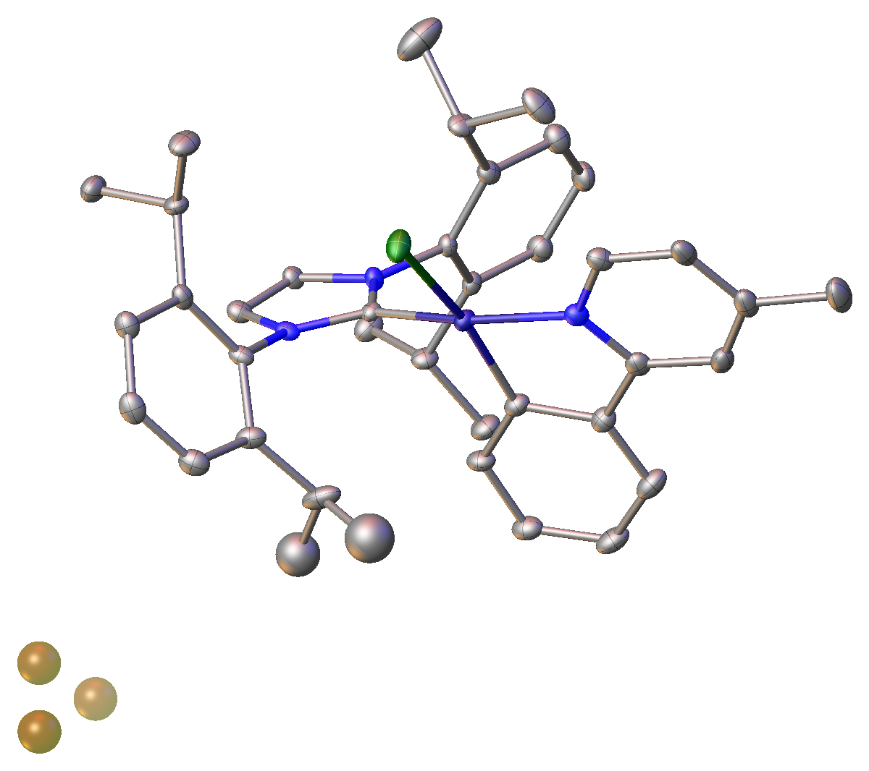
Use scattering factors and coordinates (x, y, z) for each atom (j) in the unit cell to calculate structure factors (F) for each reflection.

Slide 4
Use scattering factors and coordinates (x, y, z) for each atom (j) in the unit cell to calculate structure factors (F) for each reflection.

Slide 5
Least-squares refinement tries to minimize
Your measured intensities
Calculated from your model
Each atom in your model contributes to the calculated structure factor.

Slide 6
Least-squares refinement tries to minimize
Your measured intensities
Calculated from your model
The closer your model approximates the electron density in your unit cell, the smaller the difference.

Slide 7
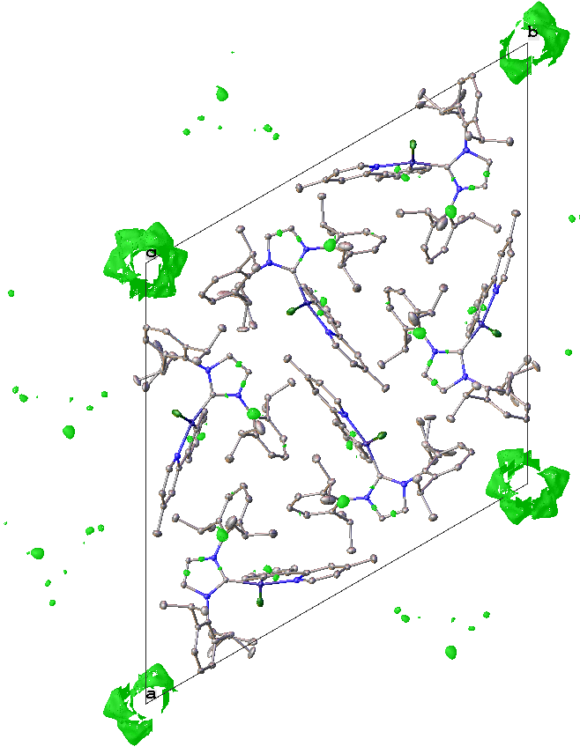
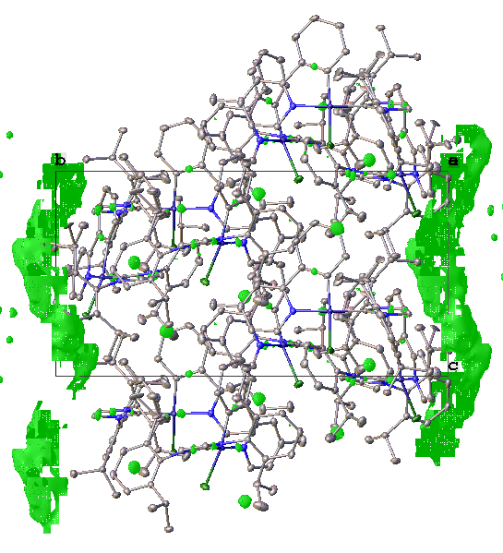

Slide 8
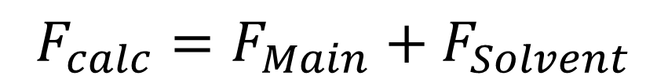
Solvent Masking
Identifies solvent accessible regions in the unit cell.
Calculates unresolved (unmodeled) electron density in that region.
SQUEEZE calculates the solvent contribution to the structure factors by back-Fourier transformation of the electron density found in the solvent-accessible region
$$F_{calc}=F_{Main}+F_{Solvent}$$

Slide 9
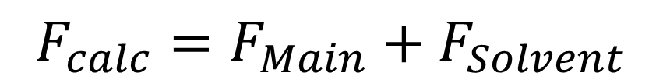
i
$$F_{calc}=F_{Main}+F_{Solvent}$$
R

Slide 10
Refine everything in the main structure, including disorder and hydrogen atoms.
Regular structures must contain the ACTA and LIST 4 command in the .ins file. This will create the .cif and .fcf in a format that can be used by SQUEEZE.
Twinned data with HKLF5 or TWIN/BASF data requires LIST 8 (not 4).

Slide 11
Initiate PLATON/SQUEEZE. It will:
- Search for solvent accessible voids
- Calculate the electron density in each void
- Calculate the correction ( .fab file) required to each reflection to remove that electron density from the void.

Slide 12
Initiate PLATON/SQUEEZE. It will:
- Creates new .ins file (name_sq.ins) containing the ABIN instruction
- Creates new .hkl file (name_sq.hkl), identical to original .hkl file
Go ahead and refine!!

